Slide 1
Operating Systems
Nirali Verma

Slide 2
Definition
Program-Manages computer hardware
Acts as intermediary between computer user and hardware.
An Operating System (OS) is a collection of software that manages computer hardware resources and provides common services for computer programs.
Low level Software ( System Software ) supports a computer's basic functions, such as memory management, tasks scheduling and controlling peripherals etc.

Slide 3
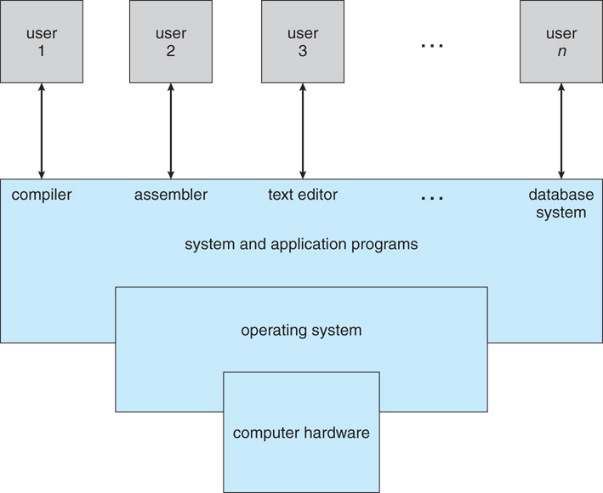
What Operating System Do?
Abstract View of the components of a computer system

Slide 4
What Operating System Do?
The hardware—the central processing unit (CPU), the memory, and the input/output (I/O) devices
The application programs—such as word processors, spreadsheets, excel, paint, compilers, and web browsers—define the ways in which these resources are used to solve users' computing problems.
The operating system controls and coordinates the use of the hardware among the various application programs for the various users.
OS manages resources ( Government model, it doesn't produce anything. )

Slide 5
User View
The user's view of the computer varies according to the interface being used.
Most computer users sit in front of a PC one user to monopolize its resources. the operating system is designed mostly for ease of use, with some attention paid to performance and none paid to resource
A users sits at a different terminal These users share resources and may, their operating system is designed to compromise between individual usability and resource utilization.
Some computers have little or no user view. For example, embedded computers in home devices and automobiles

Slide 6
System View
From the computer's point of view, the operating system is the program most intimately involved with the hardware- resource allocator.
A computer system has many resources that may be required to solve a problem: CPU time, memory space, I/O devices, and so on. The operating system acts as the manager of these resources to operate the computer system efficiently and fairly
A different view of an operating system emphasizes the need to control the various I/O devices and user programs. An operating system is a control program. A control program manages the execution of user programs to prevent errors and improper use of the computer.

Slide 7
Operating System Definition
The operating system is the one program running at all times on the computer (usually called the kernel), with all else being systems programs and application programs

Slide 8
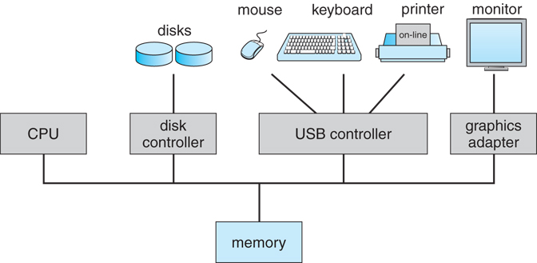
Computer System Organization-Computer System Operation
One or more CPUs-number of device controllers -common bus- shared memory. Each device controller- in charge of a specific type of device.
The CPU and the device controllers can execute concurrently, competing for memory cycles- memory controller - to synchronize access to the memory.

Slide 9
Computer System Organization
For a computer to start running- initial program, or bootstrap program- stored in read-only memory (ROM) or electrically erasable programmable read-only memory (EEPROM)-within the computer hardware- Initializes all aspects of the system, from CPU register, device controllers, memory contents.
The bootstrap program- knows to load the operating system and to start executing that system.
The bootstrap program must locate and load into memory the operating system kernel. The operating system then starts executing the first process, such as "init," and waits for some event to occur

Slide 10
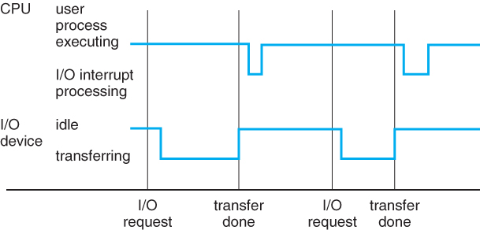
Occurrence of an event- interrupt -hardware or the software. Hardware -sending a signal to the CPU, usually by way of the system bus. Software-system call (monitor call).
CPU is interrupted-transfers execution to a fixed location(starting address of service routine)
On completion, the CPU resumes .The interrupt must transfer control to the appropriate interrupt service routine.

Slide 11
CSO-Storage Structure
Computer programs to be executed should be in main memory(RAM).
Main memory -large storage area (millions to billions of bytes) -processor can access directly.
Implemented in a semiconductor technology called DRAM-array of memory words having address
Interaction - Load (moves a word from main memory to an internal register within the CPU) and Store (moves the content of a register to main memory).
CPU automatically loads instructions from main memory for execution.-von Neumann architecture

Slide 12
CSO-Storage Structure
Programs and data cannot reside in main memory permanently due to Main memory is usually too small and volatile storage device thus secondary storage -extension of main memory.
Secondary storage holds large quantities of data permanently . Eg. Magnetic disk, which provides storage for both programs and data.
Others storage are cache memory, CD-ROM, magnetic tapes, and so on.
Differences- speed, cost, size, and volatility.

Slide 13
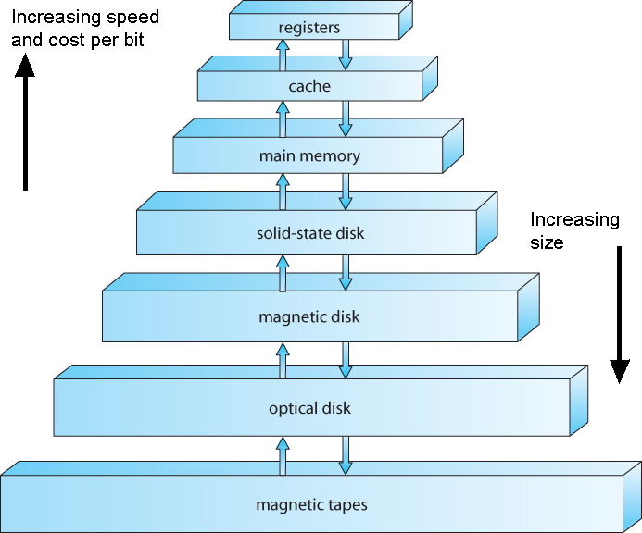
CSO-Storage Structure

Slide 14
Program and data cannot reside in main memory permanently. As Main memory is usually too small and is a volatile storage device, thus we use secondary storage as an extension of main memory. The main requirement for secondary storage is that it be able to hold large quantities of data permanently. The most common secondary-storage device is a magnetic disk, which provides storage for both programs and data.

Slide 15
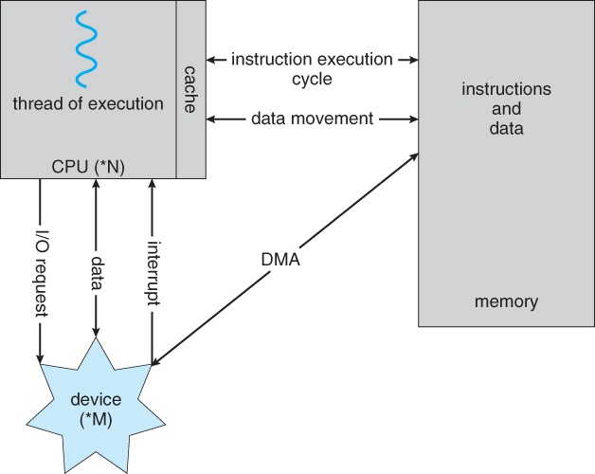
I/O structure

Slide 16
I/O Structure
A large portion of operating system code is dedicated to managing I/O because of the varying nature of the devices. A general-purpose computer system consists of CPUs and multiple device controllers that are connected through a common bus. Depending on the controller, there may be more than one attached device. For instance, seven or more devices can be attached to the small computer-systems interface (SCSI) controller. A device controller maintains some local buffer storage and a set of special-purpose registers. The device controller is responsible for moving the data between the peripheral devices that it controls and its local buffer storage. Os has device driver that understands the device controller and presents a uniform interface to the device to the rest of the operating system. To start an I/O operation, the device driver loads the appropriate registers within the device controller. The device controller, in turn, examines the contents of these registers to determine what action to take (such as "read a character from the keyboard")- The controller starts the transfer of data from the device to its local buffer.

Slide 17
Once the transfer of data is complete, the device controller informs the device driver via an interrupt that it has finished its operation. The device driver then returns control to the operating system, possibly returning the data or a pointer to the data if the operation was a read. For other operations, the device driver returns status information.
This form of interrupt-driven I/O is fine for moving small amounts of data but can produce high overhead when used for bulk data movement such as disk I/O. To solve this problem, direct memory access (DMA) is used. After setting up buffers, pointers, and counters for the I/O device, the device controller transfers an entire block of data directly to or from its own buffer storage to memory, with no intervention by the CPU. Only one interrupt is generated per block, to tell the device driver that the operation has completed, rather than the one interrupt per byte generated for low-speed devices. While the device controller is performing these operations, the CPU is available to accomplish other work.

Slide 18
Linux
Linux is an operating system's kernel. It was created by Linus Torvalds. Linux is free and open-source, that means that you can simply change anything in Linux and redistribute it in our own name! There are several Linux Distributions, commonly called “distros”.
Ubuntu Linux, Red Hat Enterprise Linux, Linux Mint and others
Linux is mainly used in servers. About 90% of the internet is powered by Linux servers.Linux is fast, secure, and free. The main problem of using Windows servers are their cost. This is solved by using Linux servers. The OS that runs in about 80% of the smartphones in the world, Android, is also made from the Linux kernel.
A shell is a program that receives commands from the user and gives it to the OS to process, and it shows the output. Linux's shell is its main part. Its distros come in GUI (graphical user interface), but basically, Linux has a CLI (command line interface).

Slide 19
Computer-System Organization-Storage Sturucture
Main memory ( RAM )
Programs must be loaded into RAM to run.
Instructions and data fetched from RAM into registers.
RAM is volatile
"Medium" size and speed
Other electronic ( volatile ) memory is faster, smaller, and more expensive per bit:
Registers
CPU Cache
Non-volatile memory ( "permanent" storage ) is slower, larger, and less expensive per bit:
Electronic disks
Magnetic disks
Optical disks
Magnetic Tapes

Slide 20
https://bellard.org/jslinux/vm.html?url=alpine-x86.cfg&mem=192
Date, cal, bc(for 6+3 etc)
localhost:~# date
Mon Sep 5 21:41:40 UTC 2022
localhost:~# cal
September 2022
Su Mo Tu We Th Fr Sa
1 2 3
4 5 6 7 8 9 10
11 12 13 14 15 16 17
18 19 20 21 22 23 24
25 26 27 28 29 30

Slide 21
localhost:~# ls
bench.py hello.c hello.js readme.txt
localhost:~# pwd
/root
localhost:~# mkdir linu
localhost:~# cd linu
localhost:~/linu# pwd
/root/linu
localhost:~/linu# cd ..
localhost:~# pwd
/root
localhost:~# rmdir linu
localhost:~# ls
bench.py hello.c hello.js readme.txt

Slide 22
localhost:~# touch a.txt
localhost:~# ls
a.txt bench.py hello.c hello.js readme.txt
localhost:~# du a.txt
0 a.txt
localhost:~# echo My name is Nancy>>a.txt
localhost:~# du a.txt
4 a.txt
localhost:~# grep Nancy a.txt(This command will search Nancy in a.txt)
My name is Nancy

Slide 23
localhost:~# echo My name is Nancy>>a.txt
localhost:~# echo I am 10 years old>>a.txt
localhost:~# du a.txt
4 a.txt
localhost:~# cat a.txt
My name is Nancy
I am 10 years old

Slide 24
localhost:~# cat a.txt
My name is Nancy
I am 10 years old
like Math
My hobbies are reading books
I stay in Pune
I have one younger brother name Ayush
localhost:~# head -n 4 a.txt
My name is Nancy
I am 10 years old
like Math
My hobbies are reading books

Slide 25
Computer System Architecture Single Processor System
Most systems use a single processor. On a single-processor system, there is one main CPU capable of executing a general-purpose instruction set, including instructions from user processes. Almost all systems have other special-purpose processors as well. They may come in the form of device-specific processors, such as disk, keyboard, and graphics controllers.
All of these special-purpose processors run a limited instruction set and do not run user processes. PCs contain a microprocessor in the keyboard to convert the key.Eg. strokes into codes to be sent to the CPU. In other systems or circumstances, special-purpose processors are low-level components built into the hardware. The operating system cannot communicate with these processors; they do their jobs autonomously. The use of special-purpose microprocessors is common and does not turn a single-processor system into a multiprocessor. If there is only one general-purpose CPU, then the system is a single-processor system.

Slide 26
Computer System Architecture Multi Processor System
Single-processor systems are common, multiprocessor systems (also known as parallel systems or tightly coupled systems) are growing in importance. Such systems have two or more processors in close communication, sharing the computer bus and sometimes the clock, memory, and peripheral devices.
Multiprocessor systems have three main advantages:
1. Increased throughput. By increasing the number of processors, we expect to get more work done in less time. The speed-up ratio with N processors is not N, however; rather, it is less than N. When multiple processors cooperate on a task, a certain amount of overhead is incurred in keeping all the parts working correctly. This overhead, plus contention for shared resources, lowers the expected gain from additional processors.

Slide 27
Computer System Architecture Multi Processor System
2. Economy of scale. Multiprocessor systems can cost less than equivalent multiple single-processor systems, because they can share peripherals, mass storage, and power supplies. If several programs operate on the same set of data, it is cheaper to store those data on one disk and to have all the processors share them than to have many computers with local disks and many copies of the data.
3. Increased reliability. If functions can be distributed properly among several processors, then the failure of one processor will not halt the system, only slow it down. If we have ten processors and one fails, then each of the remaining nine processors can pick up a share of the work of the failed processor. Thus, the entire system runs only 10 percent slower, rather than failing altogether.

Slide 28
Computer System Architecture Multi Processor System
Increased reliability of a computer system is crucial in many applications. The ability to continue providing service proportional to the level of surviving hardware is called graceful degradation. Some systems go beyond graceful degradation and are called fault tolerant, because they can suffer a failure of any single component and still continue operation. Note that fault tolerance requires a mechanism to allow the failure to be detected, diagnosed, and, if possible, corrected. The HP NonStop system (formerly Tandem) system uses both hardware and software duplication to ensure continued operation despite faults. The multiple-processor systems in use today are of two types. Some systems use
Asymmetric multiprocessing, in which each processor is assigned a specific task. A master processor controls the system; the other processors either look to the master for instruction or have predefined tasks. This scheme defines a master-slave relationship. The master processor schedules and allocates work to the slave processors.

Slide 29
Computer System Architecture Multi Processor System
The most common systems use symmetric multiprocessing (SMP), in which each processor performs all tasks within the operating system. SMP means that all processors are peers; no master-slave relationship exists between processors. Eg. Solaris, a commercial version of UNIX designed by Sun Microsystems. A Solaris system can be configured to employ dozens of processors, all running Solaris. The benefit of this model is that many processes can run simultaneously—N processes can run if there are N CPUs—without causing a significant deterioration of performance. However, we must carefully control I/O to ensure that the data reach the appropriate processor

Slide 30
Computer System Architecture Multi Processor System
Also, since the CPUs are separate, one may be sitting idle while another is overloaded, resulting in inefficiencies. These inefficiencies can be avoided if the processors share certain data structures. Virtually all modern operating systems—including Windows, Windows XP, Mac OS X, and Linux—now provide support for SMP. The difference between symmetric and asymmetric multiprocessing may result from either hardware or software. A recent trend in CPU design is to include multiple compute cores on a single chip. these are multiprocessor chips. Blade servers are a recent development in which multiple processor boards, I/O boards, and networking boards are placed in the same chassis.

Slide 31
Computer System Architecture Clustered Systems
Like multiprocessor systems, they gather together multiple CPUs to accomplish computational work. Clustered systems differ from multiprocessor systems, however, in that they are composed of two or more individual systems coupled together, Clustered computers share storage and are closely linked via a local-area network (LAN) or a faster interconnect such as InfiniBand. It is to provide high-availability service; that is, service will continue even if one or more systems in the cluster fail -by adding a level of redundancy in the system. A layer of cluster software runs on the cluster nodes. Each node can monitor one or more of the others (over the LAN). If the monitored machine fails, the monitoring machine can take ownership of its storage and restart the applications that were running on the failed machine. The users and clients of the applications see only a brief interruption of service.

Slide 32
Computer System Architecture Clustered Systems
Clustering -asymmetrically or symmetrically. In asymmetric clustering, one machine is in hot-standby mode while the other is running the applications. The hot-standby host machine does nothing but monitor the active server. If that server fails, the hot-standby host becomes the active server. In symmetric mode, two or more hosts are running applications, and are monitoring each other. This mode is obviously more efficient, as it uses all of the available hardware.
Parallel clusters allow multiple hosts to access the same data on the shared storage. Because most operating systems lack support for simultaneous data access by multiple hosts, parallel clusters are usually accomplished by use of special versions of software and special releases of applications. For example, Oracle Parallel Server is a version of Oracle's database that has been designed to run on a parallel cluster. Each machine has full access to all data in the database. To provide this shared access to data, the system must also supply access control and locking to ensure that no conflicting operations occur. This function, commonly known as a distributed lock manager (DLM), is included in some cluster technology.
In a database cluster, dozens of hosts can share the same database, increasing performance and reliability.

Slide 33
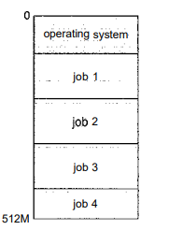
Operating System Structure
One of the most important aspects of operating systems is the ability to multiprogram. Multiprogramming increases CPU utilization by organizing jobs (code and data) so that the CPU always has one to execute. The idea is as follows: The operating system keeps several jobs in memory simultaneously. This set of jobs can be a subset of the jobs kept in the job pool—which contains all jobs that enter the system—since the number of jobs that can be kept simultaneously in memory is usually smaller than the number of jobs that can be kept in the job pool. The operating system picks and begins to execute one of the jobs in memory. Eventually, the job may have to wait for some task, such as an I/O operation, to complete.

Slide 34
Operating System Structure
In a multiprogrammed system, the operating system simply switches to, and executes, another job. When that job needs to wait, the CPU is switched to another job, and so on Time sharing (or multitasking) is a logical extension of multiprogramming. In time-sharing systems, the CPU executes multiple jobs by switching among them, but the switches occur so frequently that the users can interact with each program while it is running.
A time-shared operating system allows many users to share the computer simultaneously. Since each action or command in a time-shared system tends to be short, only a little CPU time is needed for each user. As the system switches rapidly from one user to the next, each user is given the impression that the entire computer system is dedicated to his use, even though it is being shared among many users.

Slide 35
Operating System Structure
A time-shared operating system uses CPU scheduling and multiprogramming (small portion of a time-shared computer).Program in memory and executing is called a process
Time-sharing and multiprogramming require several jobs to be kept simultaneously in memory.(too small ) to accommodate all jobs, the jobs are kept initially on the disk in the job pool. If several jobs are ready to be brought into memory, and if there is not enough room for all of them, then the system must choose among them. Making this decision is job scheduling. When the operating system selects a job from the job pool, it loads that job into memory for execution. Having several programs in memory at the same time requires some form of memory management.

Slide 36
Operating System Structure
In a time-sharing system, the operating system must ensure reasonable response time, which is sometimes accomplished through swapping, where processes are swapped in and out of main memory to the disk. A more common method for achieving this goal is virtual memory, a technique that allows the execution of a process that is not completely in memory. It enables users to run programs that are larger than actual physical memory.

